Slide 1


Huy Nguyen Tuan
22 August 2024

Slide 2

Outline
Executive Summary
Introduction
Methodology
Results
Conclusion
Appendix

Slide 3
Executive Summary
Summary of methodologies
SpaceX Data Collection using SpaceX API
SpaceX Data Collection with Web Scraping
SpaceX Data Wrangling
SpaceX Exploratory Data Analysis using SQL
SpaceX EDA DataViz Using Python Pandas and Matplotlib
Space-X Launch Sites Analysis with Folium-Interactive Visual Analytics and Ploty Dash
SpaceX Machine Learning Landing Prediction
Summary of all results
EDA results
Interactive Visual Analytics and Dashboards
Predictive Analysis(Classification)

Slide 4
Introduction
Project background and context
SpaceX advertises Falcon 9 rocket launches on its website with a cost of 62 million dollars; other providers cost upward of 165 million dollars each, much of the savings is because SpaceX can reuse the first stage. Therefore if we can determine if the first stage will land, we can determine the cost of a launch. This information can be used if an alternate company wants to bid against SpaceX for a rocket launch.
Problems you want to find answers
In this capstone, we will predict if the Falcon 9 first stage will land successfully using data from Falcon 9 rocket launches advertised on its website.

Slide 5

Section 1

Slide 6
Methodology
Executive Summary
Data collection methodology:
With Rest API and Web Scraping
Perform data wrangling
Data were transformed and one hot encoded to be apply later on the ML models
Perform exploratory data analysis (EDA) using visualization and SQL
Discovering new pattern in the data with visualization techniques such as scatter plots
Perform interactive visual analytics using Folium and Plotly Dash
Dash and Folium were used to achieve this goal
Perform predictive analysis using classification models
Classification machine learning models were built to achieve this goal

Slide 7
Data Collection
Data sets were collected using the APO call from several websites, I collected rocket, launchpad, payloads and cores data from https://api.spacexdata.com/v4 website.
1. Collecting the data with API call
2. Converting to data frame with help of JSON
3. Updating columns and rows (pre-processing)
4. Filtering the data to keep only Falcon 9 launches
5. Convert the data to csv file with name ‘dataset_part_1.csv’

Slide 8
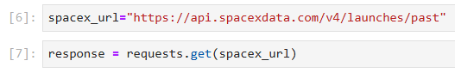
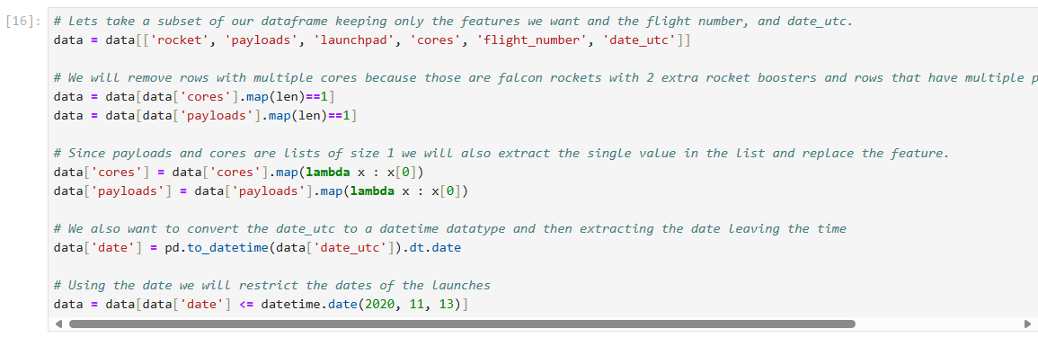
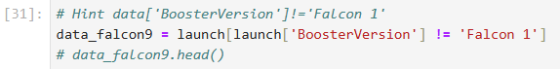
Github repo: DS_Coursera/jupyter-labs-spacex-data-collection-api.ipynb at master · huynguyentuank22/DS_Coursera (github.com)
Data Collection – SpaceX API
1. Collecting the data with API call
2. Converting to data frame with help of JSON
3. Updating columns and rows (pre-processing)
4. Filtering the data to keep only Falcon 9 launches
5. Convert the data to csv file with name ‘dataset_part_1.csv’

Slide 9
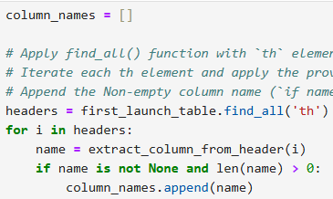
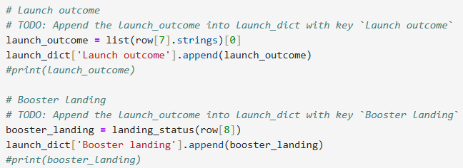
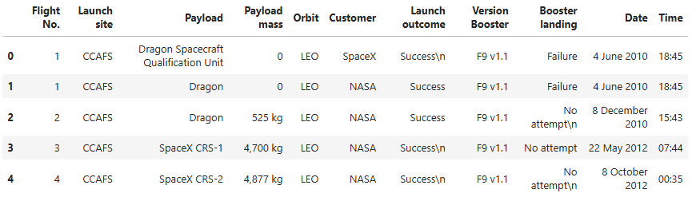
Github repo: DS_Coursera/jupyter-labs-webscraping.ipynb at master · huynguyentuank22/DS_Coursera (github.com)
Data Collection - Scraping
1. Creating the BeautifulSoup
2. Getting column names
3. Creating the launch_dict
4. Converting the final dataframe
5. Convert the data to csv file with name ‘spacex_web_scraped.csv’

Slide 10
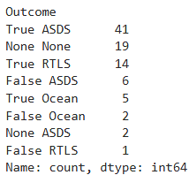
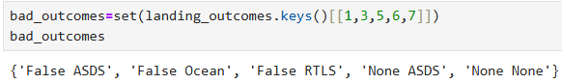
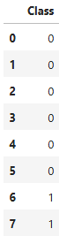
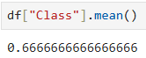
Github repo: DS_Coursera/labs-jupyter-spacex-Data wrangling.ipynb at master · huynguyentuank22/DS_Coursera (github.com)
Data Wrangling
1. Loading the dataset
2. Creating landing outcomes
3. Finding the bad outcomes
5. Determining the success outcome
4. Presenting outcomes as 0 and 1
6. Convert the data to csv file with name ‘spacex_part_2.csv’

Slide 11
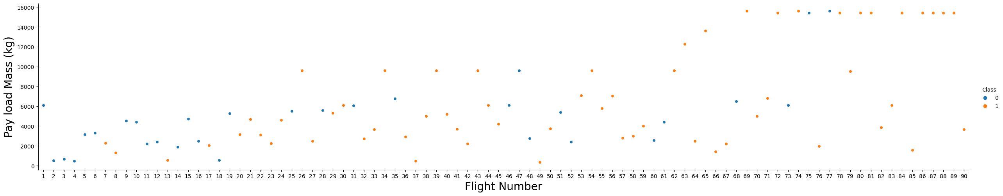
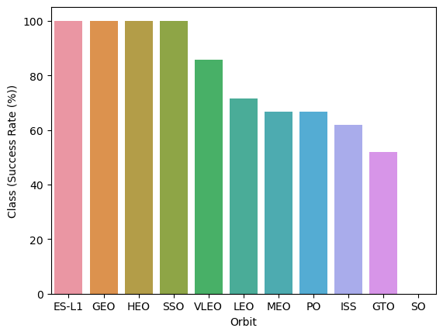
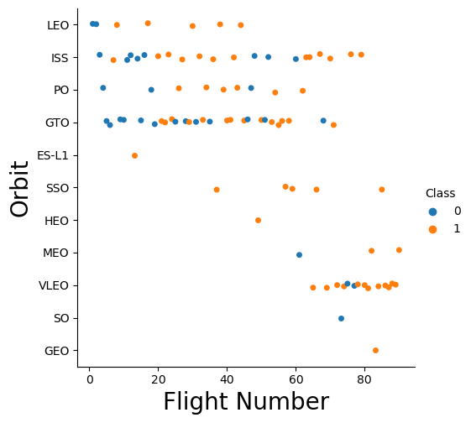
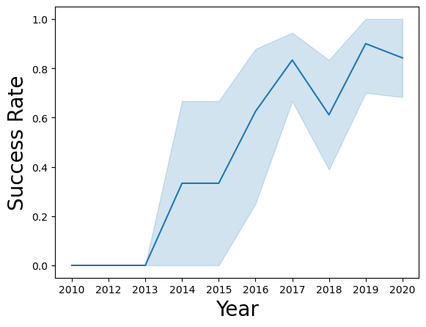
Github repo: DS_Coursera/jupyter-labs-eda-dataviz.ipynb at master · huynguyentuank22/DS_Coursera (github.com)
EDA with Data Visualization
Categorial plot between Flight number and Payload mass (kg)
Bar chart between Orbit and Success rate of each orbit
Scatter plot between Orbit and Flight number
Line chart between Year and Success rate

Slide 12
Github repo: DS_Coursera/jupyter-labs-eda-sql-coursera_sqllite.ipynb at master · huynguyentuank22/DS_Coursera (github.com)
EDA with SQL
The following SQL queries were performed for EDA
Display the names of the unique launch sites in the space mission
Display 5 records where launch sites begin with the string 'CCA’
Display the total payload mass carried by boosters launched by NASA (CRS)
Display average payload mass carried by booster version F9 v1.1
List the date when the first succesful landing outcome in ground pad was acheived.
List the names of the boosters which have success in drone ship and have payload mass greater than 4000 but less than 6000
List the total number of successful and failure mission outcomes
List the names of the booster_versions which have carried the maximum payload mass. Use a subquery
List the records which will display the month names, failure landing_outcomes in drone ship ,booster versions, launch_site for the months in year 2015.
Rank the count of landing outcomes (such as Failure (drone ship) or Success (ground pad)) between the date 2010-06-04 and 2017-03-20, in descending order.

Slide 13
Build an Interactive Map with Folium
folium.Marker() was used to create marks on the map.
folium.Circle() was used to create circles above markers on the map.
folium.Icon() was used to create an icon on the map.
folium.PolyLine() was used to create polynomial line between the points.
folium.plugins.AntPath() was used to create animated line between the points.
makerCluster() was used to simplify the maps which contain several markers with identical coordination.
Github repo: DS_Coursera/lab_jupyter_launch_site_location.ipynb at master · huynguyentuank22/DS_Coursera (github.com)

Slide 14
Build a Dashboard with Plotly Dash
Dash and html components were used as they are the most important thing and almost everything depends on them, such as graphs, tables, dropdowns, etc.
Pandas was used to simplifying the work by creating dataframe.
Plotly was used to plot the graphs.
Pie chart and scatter chart were used to for plotting purposed.
Rangeslider was used for payload mass range selection.
Dropdown was used to launch sites.
Github repo: DS_Coursera/spacex_dash_app.py at master · huynguyentuank22/DS_Coursera (github.com)

Slide 15
Predictive Analysis (Classification)
1. Builing the model
Create column for the class
Standardize the data
Split the data into train and test sets
Build GridSearchCV model and fit the data
2. Evaluating the model
Calculating the accuracies
Calculating the confusion matrixes
Plot the results
3. Updating columns and rows (pre-processing)
Find the best hyperparameters for the models
Find the best model with highest accuracy
Confirm the optimal model

Slide 16
Results
Exploratory data analysis results
Interactive analytics demo in screenshots
Predictive analysis results

Slide 17

Section 2

Slide 18
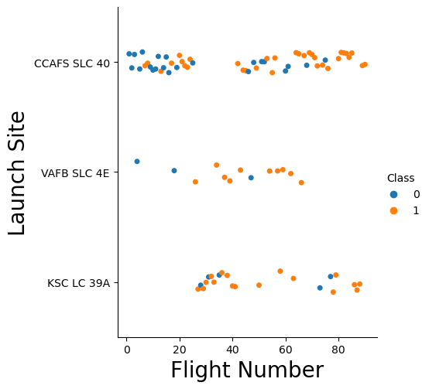
Flight Number vs. Launch Site
With the increase of flight number, the success rate is increasing as well in the launch sites

Slide 19
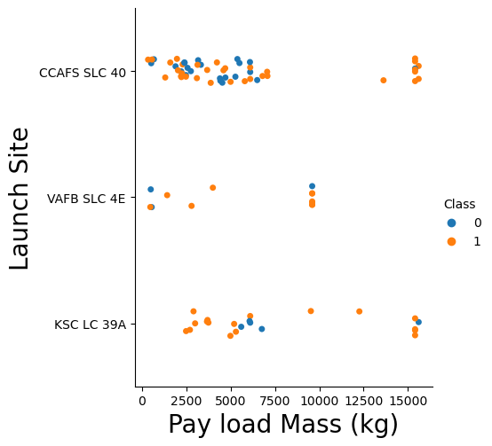
Payload vs. Launch Site
With the increase of Payload Mass, the success rate is increasing as well in the launch sites

Slide 20
Success Rate vs. Orbit Type
ES-L1, GEO, HEO, SSO have a success rate of 100%
SO has a success rate of 0%

Slide 21
Flight Number vs. Orbit Type
It’s hard to tell anything here, but we can say there is no actual relationship between flight number and GTO

Slide 22
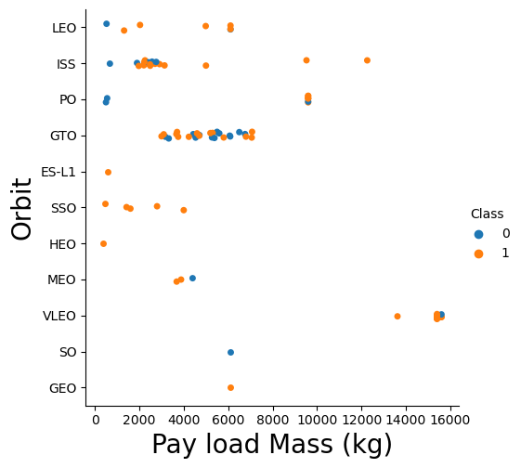
Payload vs. Orbit Type
First thing to see in how the Payload Mass between 2000 and 3000 is affecting ISS.
Similarly, Payload Mass between 3000 and 7000 is affecting GTO.

Slide 23
Launch Success Yearly Trend
Since the year 2013, there was a massive increase in success rate. However, it dropped little in 2018 but later it got stronger than before.

Slide 24
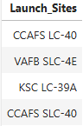
All Launch Site Names
We can get the unique values by using “DISTINCT”

Slide 25
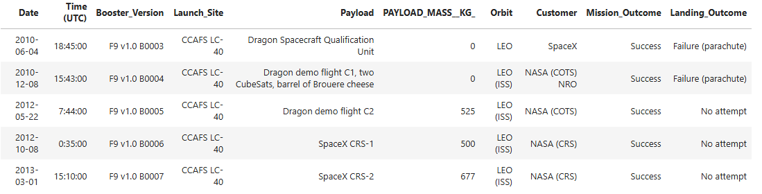
Launch Site Names Begin with 'CCA'
We can get only 5 rows by using “LIMIT”

Slide 26
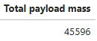
Total Payload Mass
We can get the sum of all values by using “SUM”

Slide 27
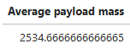
Average Payload Mass by F9 v1.1
We can get the average of all values by using “AVG”

Slide 28
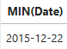
First Successful Ground Landing Date
We can get the first successful data by using “MIN”, because the first date is same with the minimum date

Slide 29
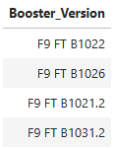
Successful Drone Ship Landing with Payload between 4000 and 6000
The payload mass data was taken between 4000 and 6000 only, and the landing outcome was determined to be “success drone ship”

Slide 30
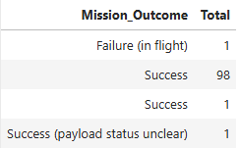
Total Number of Successful and Failure Mission Outcomes
We can get to total number of successful and failure mission by using “COUNT” and “GROUP BY”

Slide 31
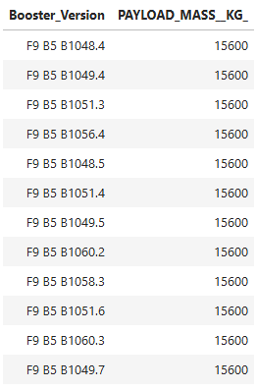
Boosters Carried Maximum Payload
We can get the maximum payload masses by using “MAX”

Slide 32
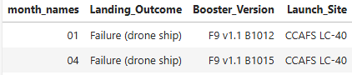
2015 Launch Records
We can get the months by using month(DATE) and in the WHERE function we assigned the year value to “2015”

Slide 33
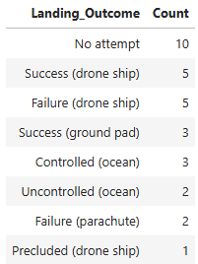
Rank Landing Outcomes Between 2010-06-04 and 2017-03-20
By using “ORDER” we can order the values in descending order, and with “COUNT” we can count all numbers as we did previously

Slide 34

Section 3

Slide 35

All Launch Sites Location Markers
All the launches are near USA, Florida, and California

Slide 36
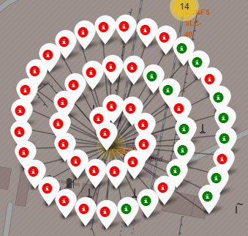
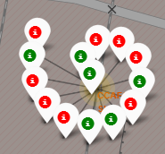
Color-labeled Launch Outcomes
Green means Successful
Red means Failure

Slide 37
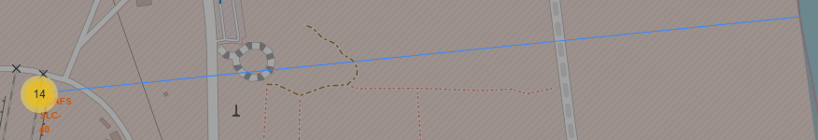
Launch Sites to its Proximities
The distance from launch sites to its proximite

Slide 38

Section 4

Slide 39
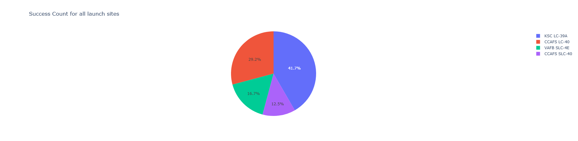
Launch Success Count
KSC LC-39A has the highest success score with 41.7%
CCAFS LC-40 comes next with 29.2%
Finally, VAFB SLC-4E and CCAFS SLC-40 with 16.7% and 12.5% respectively

Slide 40

Launch Site with Highest Score
KSC LC-39A has the highest score with 76.9% with payload range of 2000kg – 10000kg, and FT booster version has the highest score

Slide 41
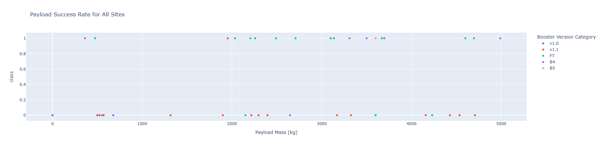
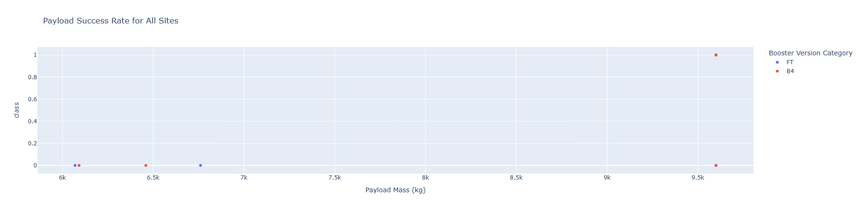
Payload vs Launch Outcome
Payload 0kg – 5000kg (first half)
Payload 6000kg – 10000kg (second half)

Slide 42

Section 5

Slide 43
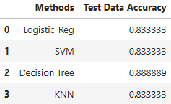
Classification Accuracy
Decision Tree has the highest accuracy with almost 0.89, then comes the remaining models with almost same accuracy of 0.83

Slide 44
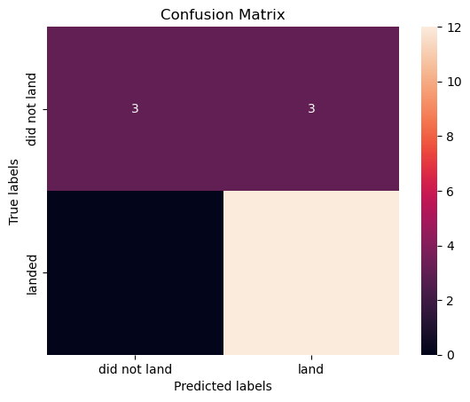
Confusion Matrix

Slide 45
Conclusions
We found the site with highest score which was KSC LC-39A
The payload of 0kg to 5000kg was more diverse than 6000kg to 10000kg
Decision Tree was the optimal model with accuracy of almost 89%
We calculated the launch sites distance to its proximities

Slide 46
Appendix
All code can be found on my Github
Github repo: https://github.com/huynguyentuank22/DS_Coursera.git

Slide 47


